Slide 1
Digital Rights Management (DRM)

Slide 2
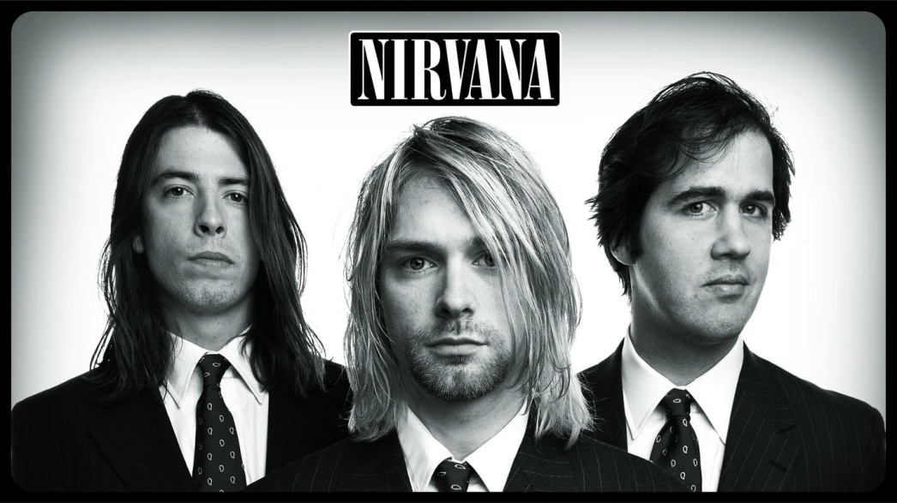
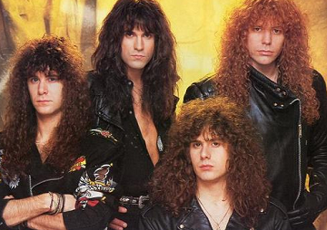
1992
Notes:
Back in 1992, before most of you were born, when grunge was taking over the music scene and the future president was jamming away on a saxophone as part of his presidential campaign, I purchased my very first computer game (next slide)

Slide 3
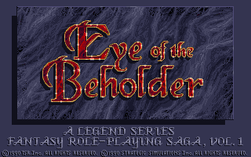
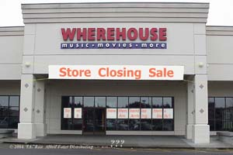
Notes:
Eye of the Beholder from the bargain bin of my local Wherehouse video store. Eye of the Beholder is a fantastic role playing game where you go into the sewer system beneath the city of Waterdeep to battle one of these (next slide)

Slide 4

Notes:
a beholder(next slide)

Slide 5
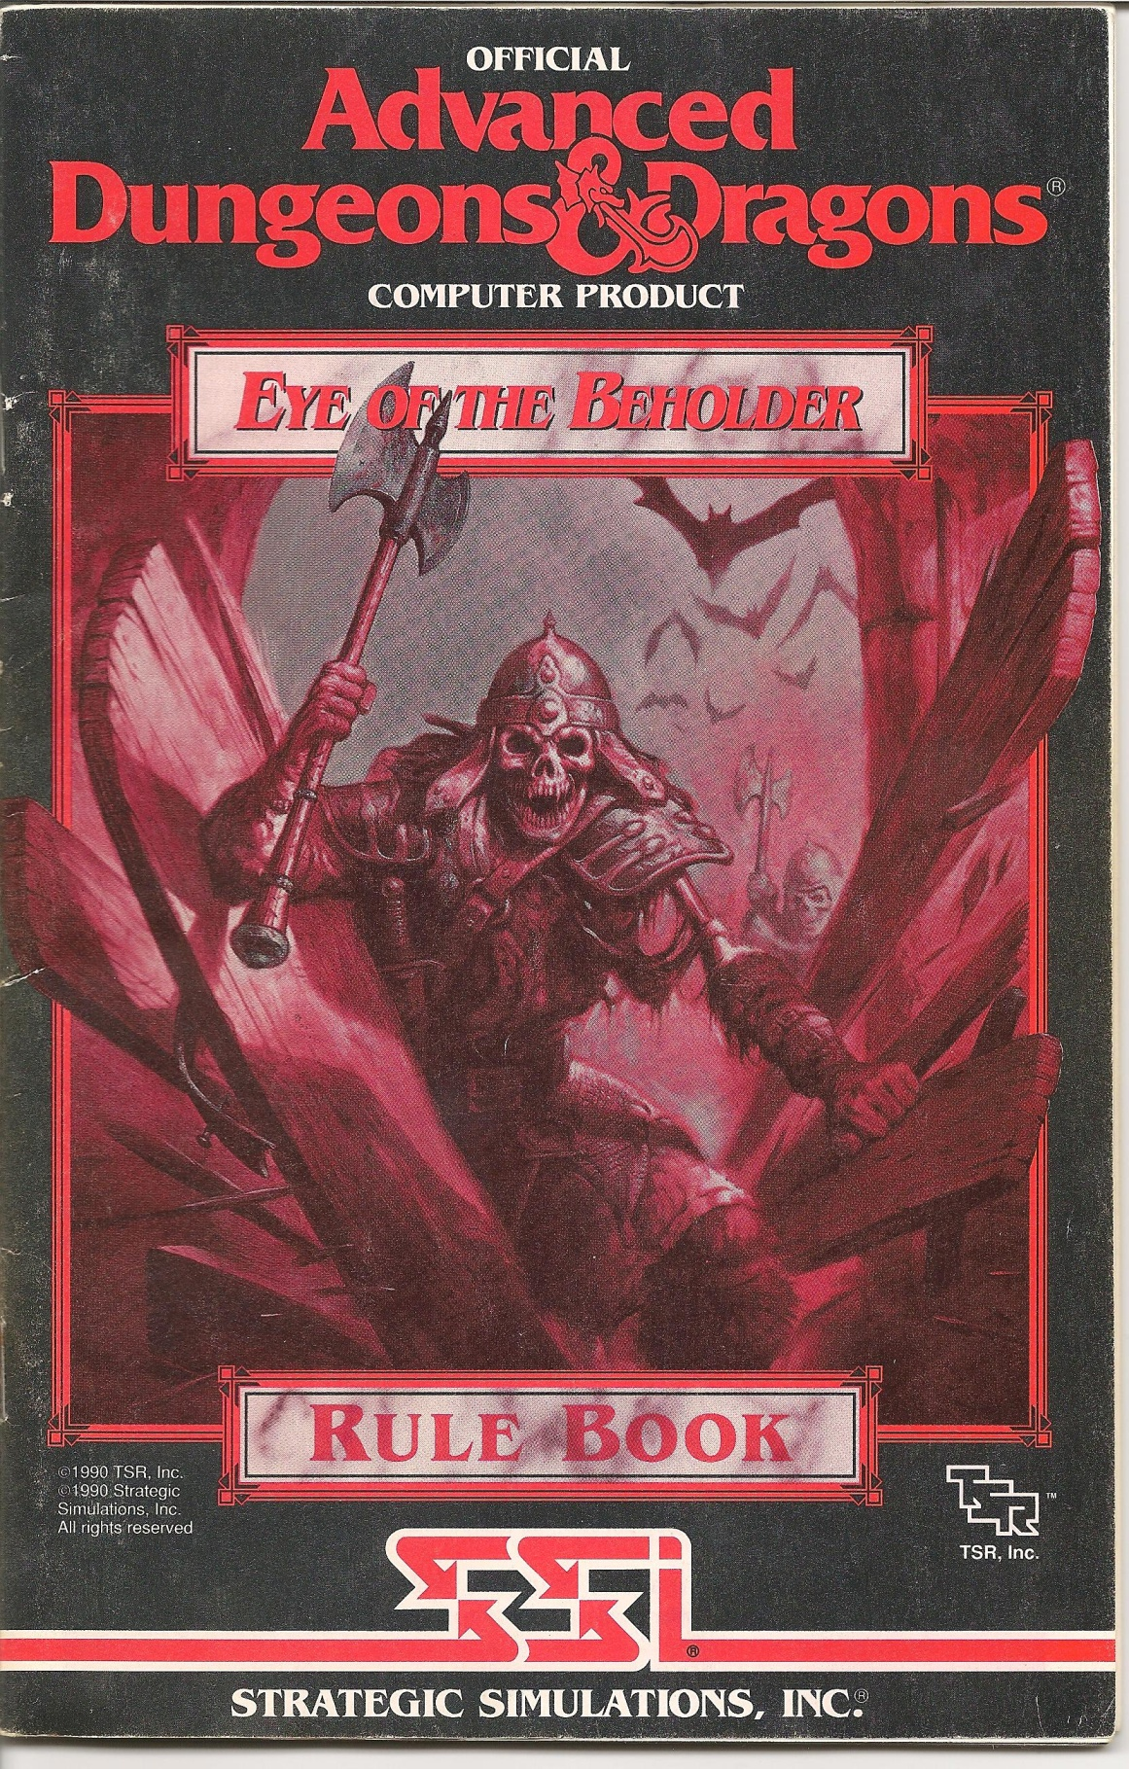
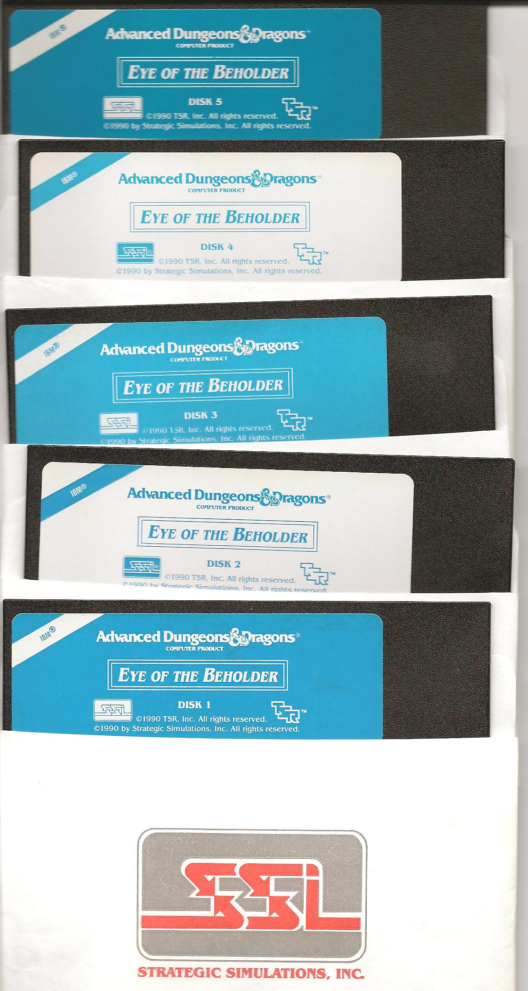
Notes:
Presented in 256 glorious colors and featuring an awesome synthesized soundtrack, I was totally immersed in its puzzle solving and combat. That is until I came to the end of the first level and was presented with a prompt much like this (next slide)

Slide 6
Notes:
I was taken completely out of my immersive experience. The game asked me to fish my manual out of the closet, open it up and (next slide)

Slide 7
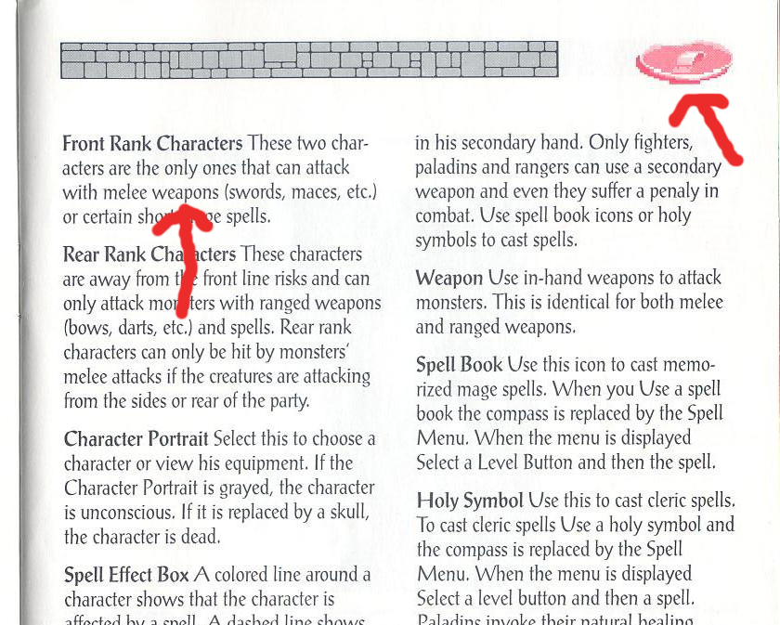
Notes:
Find the page with the shield symbol. And then find the 3rd word on the 3rd line on that page and enter it into the box. If you tried entering a different word or slightly misspelled that word, you were completely kicked out of the game without even being given an opportunity to save. This was my first experience with DRM.

Slide 8
What is DRM?
DRM refers to various access control technologies that are used to restrict the usage of proprietary software, hardware, or content.
Notes:
So what is DRM? DRM is a way for content creators to restrict how you use the content you purchase from them. It’s primary use on the consumer level is to stop(next slide)

Slide 9

Yarrrr!
Notes:
this guy. No, it’s not designed to stop Johnny Depp from making another Pirates of the Caribbean movie (though God knows I wish it could). It’s designed to stop digital piracy.

Slide 10
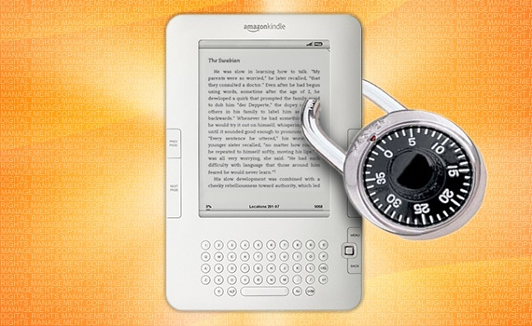
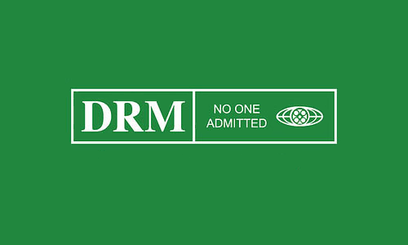
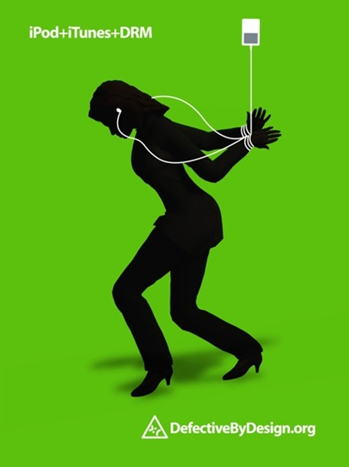
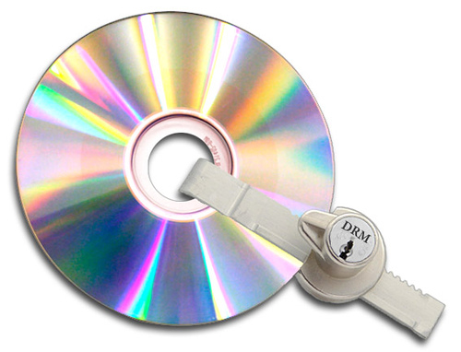
Notes:
DRM has been used absolutely everywhere: games, movies, applications, e-books, music, cell phones, even(next slide)

Slide 11

Notes:
cars. That’s right. Here is the Zoe (Zoey) electric car from French car manufacturer Renault (Ren-oh). The Zoe doesn’t come with a battery. You rent the battery from Renault, and when the contract expires, they can actually prevent your car battery from charging using DRM. (next slide)

Slide 12
Types of DRM
Notes:
Here are just a few of the various DRM methods (next slide)

Slide 13

Encryption Key
Notes:
The encryption key method is most prominent today in DVDs and Blu-rays. It works just like this picture, a lock and key system. Your content is scrambled and locked and the key to make it accessible is in an authorized device. (next slide)

Slide 14
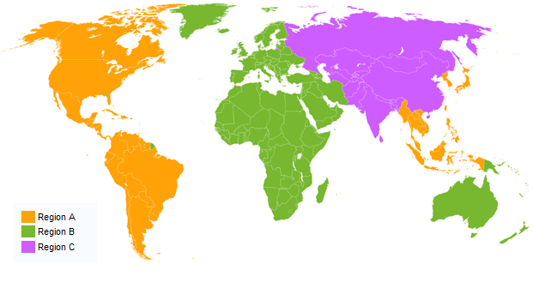
Region Locking
Notes:
Region locking prevents users from a certain regions of the world from using content designed to be sold in other regions in the world. This prevents people in America, for example, from buying content from countries where it may be cheaper, such as Romania. (next slide)

Slide 15
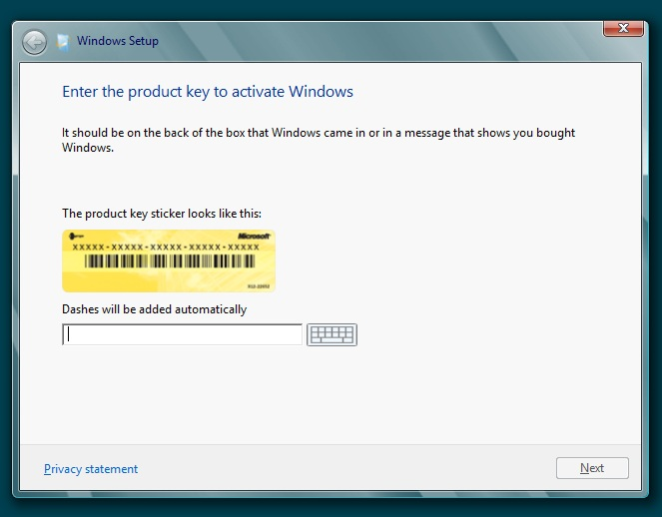
One Time Activation (Serial Key)
Notes:
One time activation requires the user to input a code into the program. The program then checks the authenticity of this key, either inside the program itself, or on a remote server. Sometimes this code is then tied to the user or computer it is installed on. (next slide)

Slide 16
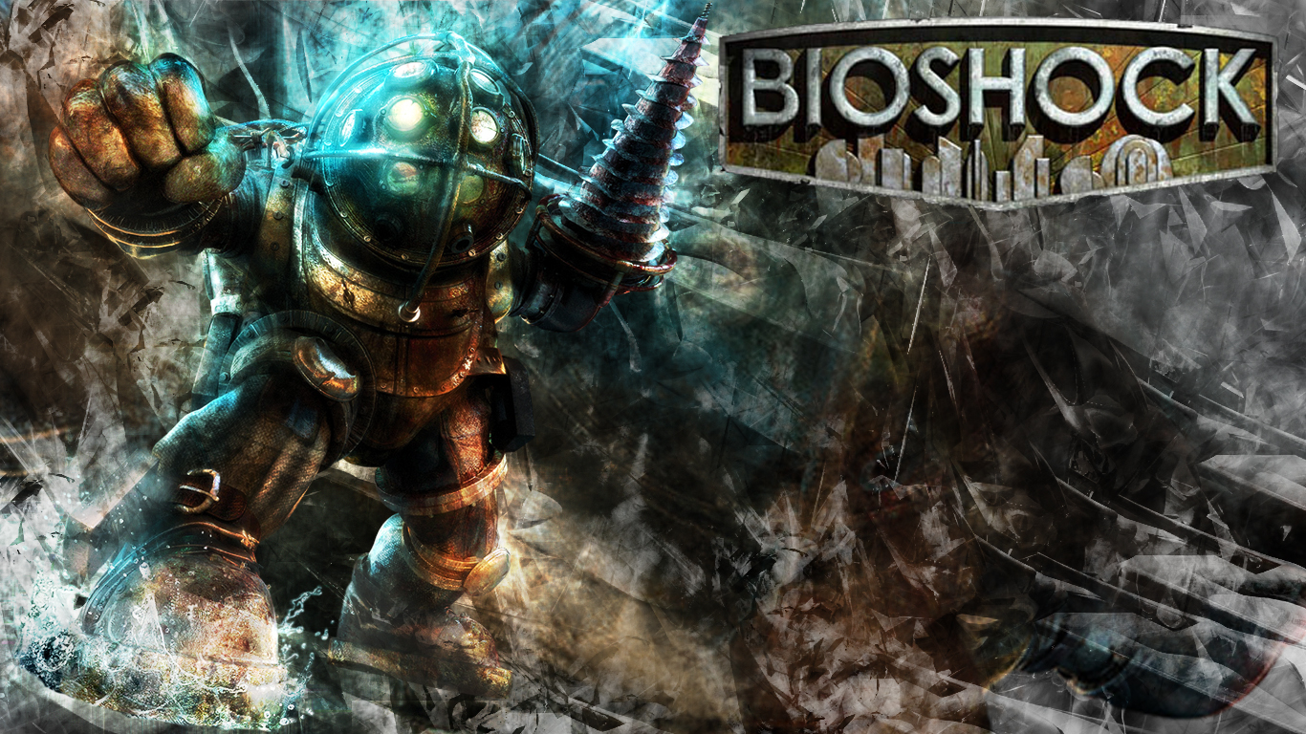
One Time Activation (Serial Key)
Notes:
2k games, the creator of the game Bioshock had a famous snafu with activation of its pc version in 2007. The game only allowed 2 installs. After 2 installs, you were required to activate the game on the phone, but get this (pause) they printed the wrong phone number in the manual. (next slide)

Slide 17
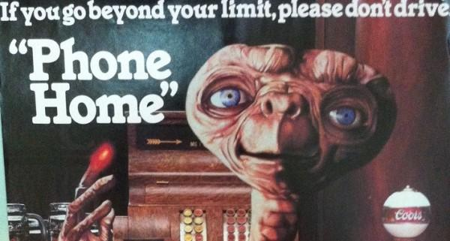
Phoning Home
Notes:
DRM that uses a ‘Phone Home’ strategy requires a periodic connection to a server or you get blocked from accessing the content. Think of it like your mother giving you an allowance, but on the condition that you call her every Sunday. You stop calling her, and she cuts you off. (next slide) reword this

Slide 18
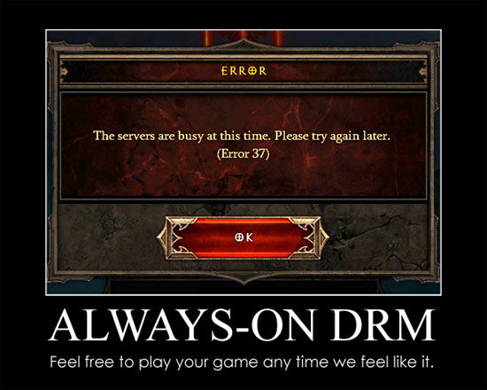
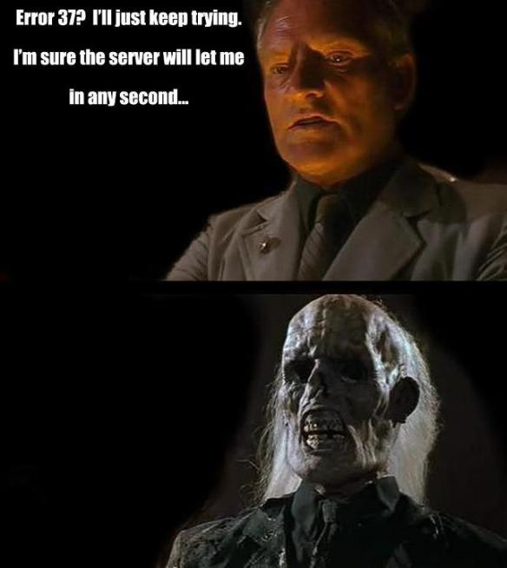
Always-On DRM
Notes:
And the big brother to phoning home, and the bane of many consumers, Always On DRM. Always on DRM requires a constant connection to a remote server that the content creator maintains in some fashion. (next slide)

Slide 19
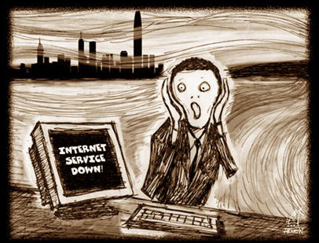
Always-On DRM
Notes:
If your connection is lost for ANY reason, you lose access to the content. This type of DRM is especially bad for people with shoddy internet access, like those in rural America. (next slide)

Slide 20

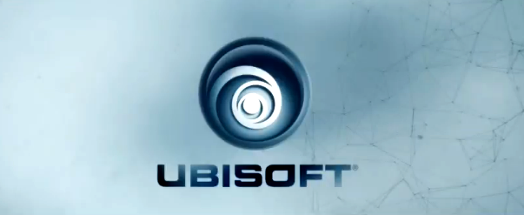
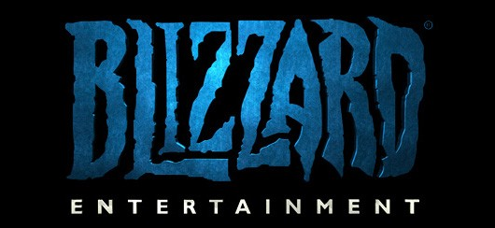
Always-On DRM
Notes:
Over the last few years, there have been several prominent gaming companies that have had PR disasters during the launches of their games due to their use of always-on DRM, including EA, Ubisoft, and Blizzard. (next slide)

Slide 21
Creative DRM
Notes:
There have also been several cases of creative and often amusing DRM methods in gaming. In the game Serious Sam 3, if you play a pirated copy of the game, you face an invincible pink scorpion that eventually kills you. The beauty of this is that the scorpion doesn’t show up until a later portion of the game (next slide)

Slide 22
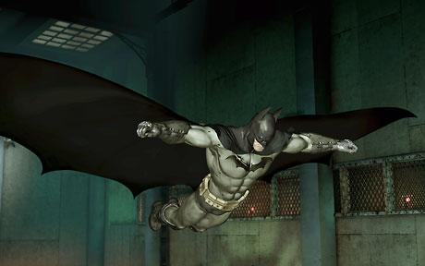
Creative DRM
Notes:
In Batman: Arkham Asylum, you play as the eponymous Batman, going around Arkham Asylum dispensing justice to escaped inmates. There is a game mechanic that allows you to fly through the air using the glider shown here … in the legal copy. In the pirated version, your glider doesn’t so much glide as flops around and makes you fall to your death. (next slide)

Slide 23
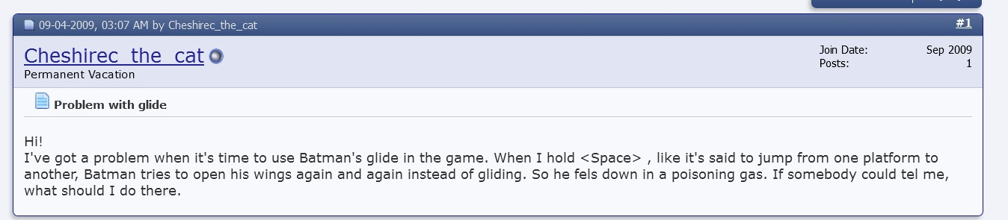
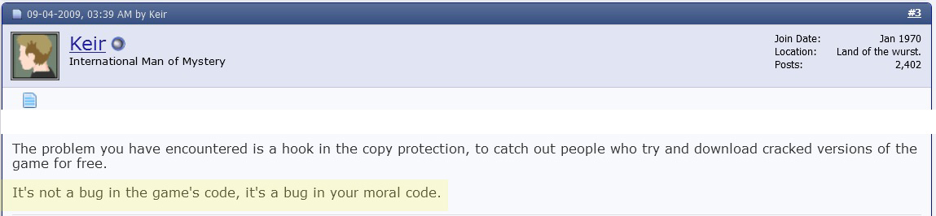
Creative DRM
Notes:
One guy was brazen enough to actually post about this on the developers official forum. A dev’s response: “It’s not a bug in the game’s code, it’s a bug in your moral code” (next slide)

Slide 24
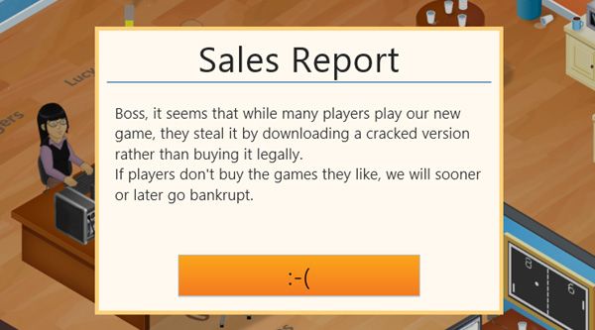
Creative DRM
Notes:
In Game Dev Tycoon, a game that simulates what it’s like to be a game developer, if you play a pirated copy, your company in-game will eventually go bankrupt because of piracy. The beauty of this is that the legal game has no DRM. The developers released this DRM-filled version via torrents claiming that it had the DRM-removed. This removal of DRM is called (next slide)

Slide 25

Notes:
Cracking. And this is where we get into some sticky legal territory. (next slide)

Slide 26
Legal Issues
Digital Millenium Copyright Act signed into law by President Clinton in 1998 made it a FEDERAL crime to circumvent DRM.
Notes:
Now if you’ve ever visited your local courthouse, you know the legal system is slow. In 1998 the Saxman himself signed into law the Digital Millenium Copyright Act (DMCA) which made it a FEDERAL crime to circumvent DRM. (next slide)

Slide 27

Legal Issues
2009: Exemptions for college professors and film students
DVDs
2012: Exemptions for all college students and K-12 educators
DVDs and online video
Notes:
However, in 2009 the Library of Congress added exemptions to the DMCA to allow college professors and film students to bypass the DRM on DVDs to allow for fair use in class work. In 2012, over 14 years after the DMCA was passed, these exemptions were further expanded to finally included ALL college students and k-12 educators as well as expanding these exemptions into online video content. But there is still a problem (next slide)

Slide 28

Legal Issues
Notes:
Lets say you have a friend or family member, say your sweet old mother (ok, maybe this is your grandmother), who is a Kindergarten teacher. Your mother wants to take a clip of a children’s DVD like March of the Penguins for use in an educational presentation for her class. As of 2012, if is now perfectly legal for her to do so. But she doesn’t know how to get around the DRM, and asks you for help. Get this: it is still illegal for you to show her how to do it. You can be sued and imprisoned if you do so. Now is it likely you would get sued for helping her? No, but what would you do in this situation? This is a moral question I cannot answer for you(next slide)

Slide 29

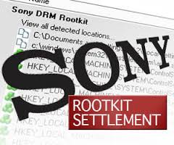
Consumer Issues
DRM can damage your system
DRM can give hackers access to your system
Notes:
Here are some other problems consumers can face with DRM:
DRM can damage your system: StarForce drm was notorious for this. It could damage the drivers that control your CD or DVD drive, or even delete crucial system files, making your system unable to boot
DRM can give people with malicious intent access to your system. In 2005, Sony BMG was sued for including Rootkits on their audio CDs that were silently installed when played in computers. Rootkits can allow unauthorized access to you computer by allowing a hacker to act like an administrator. (next slide)

Slide 30
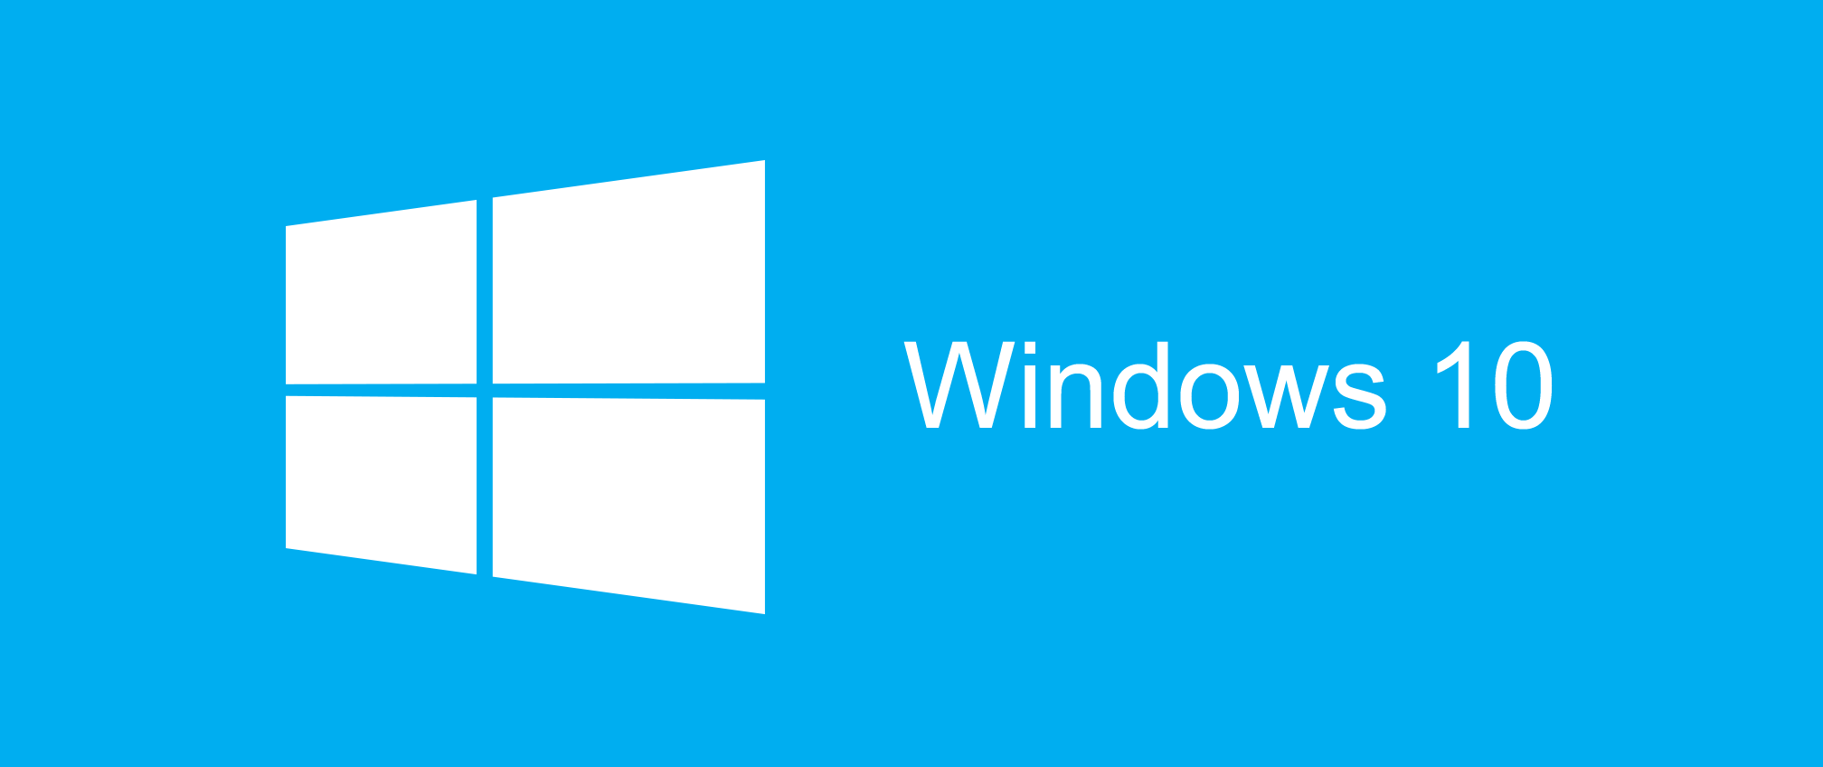

Consumer Issues
DRM can give companies excessive control
DRM can slow your system
Notes:
DRM can give companies excessive control. Have any of you upgraded to Windows 10 recently? (show hands) Congratulations, you agreed to let Microsoft monitor your applications and shut them off at will.
DRM can degrade the performance of your system and slow it to a crawl. Many DRM schemes run in the background constantly, eating up precious system resources. (next slide)

Slide 31

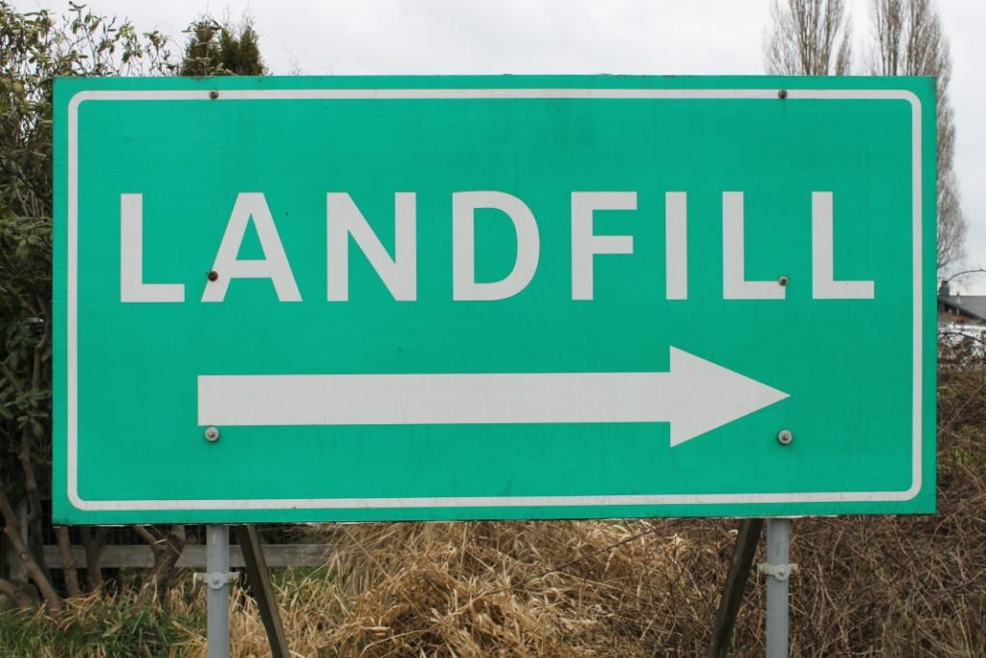
Consumer Issues
DRM can make your product unusable/devalued
DRM can increase pollution
Notes:
What happens when a company goes out of business and is forced to shut down their authentication servers ? You have a worthless product. Look at the used PC games market. You used to be able to sell your copy of a game you beat to other people to recoup some of the cost, but with DRM, that game is often forever tied to you. (next slide)
Another side effect tied to unusability that people don’t always think about is that these useless products are often discarded, leading to increased pollution

Slide 32
So why do companies still use DRM?
Notes:
So with all these negatives, why do some companies still use drm? (next slide)

Slide 33
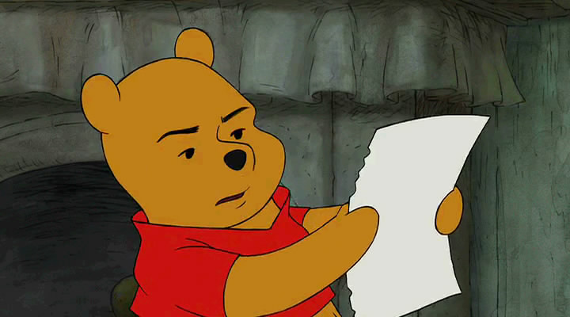
Obligation to Shareholders/Investors
Notes:
Companies often pander to their shareholders with regards to DRM. It is one of those things an executive can tick off in an Excel spreadsheet and go “look shareholders, we’re trying to fight piracy”. (next slide)

Slide 34
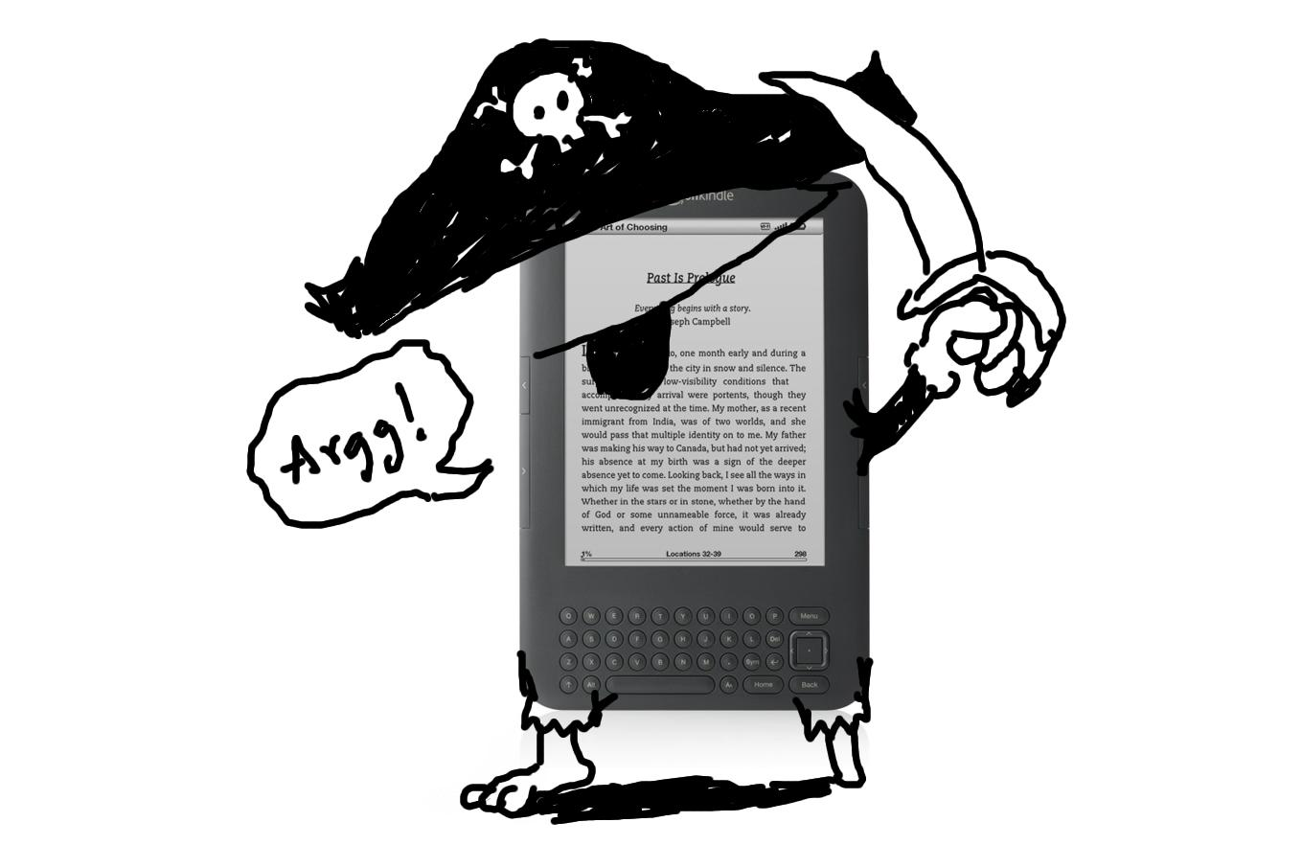
Publishers Force Content Creators
Notes:
Sometimes, content creators do not wish to put DRM in their products, but are forced to do so by publishers. This happens often in the gaming and especially the e-book industries. (next slide)

Slide 35
Alternatives to DRM
Notes:
DRM is the wrong way to combat piracy because it assumes guilt on the part of the paying consumer. Here are some alternatives to the DRM model in combating piracy (next slide)

Slide 36
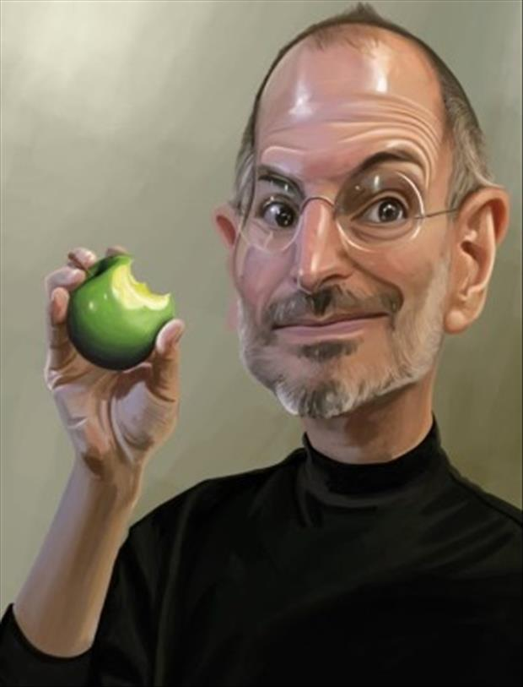
DRM- Free
10%
Notes:
The simplest alternative is to simply not use DRM at all. The method has worked for the music industry. In 2009, Steve Jobs released a letter indicating that iTunes would go DRM-free. In the years since this change, most other music retailers followed suit. A 2013 research study found that music industry sales actually INCERASED by 10% after ditching DRM. (next slide)

Slide 37
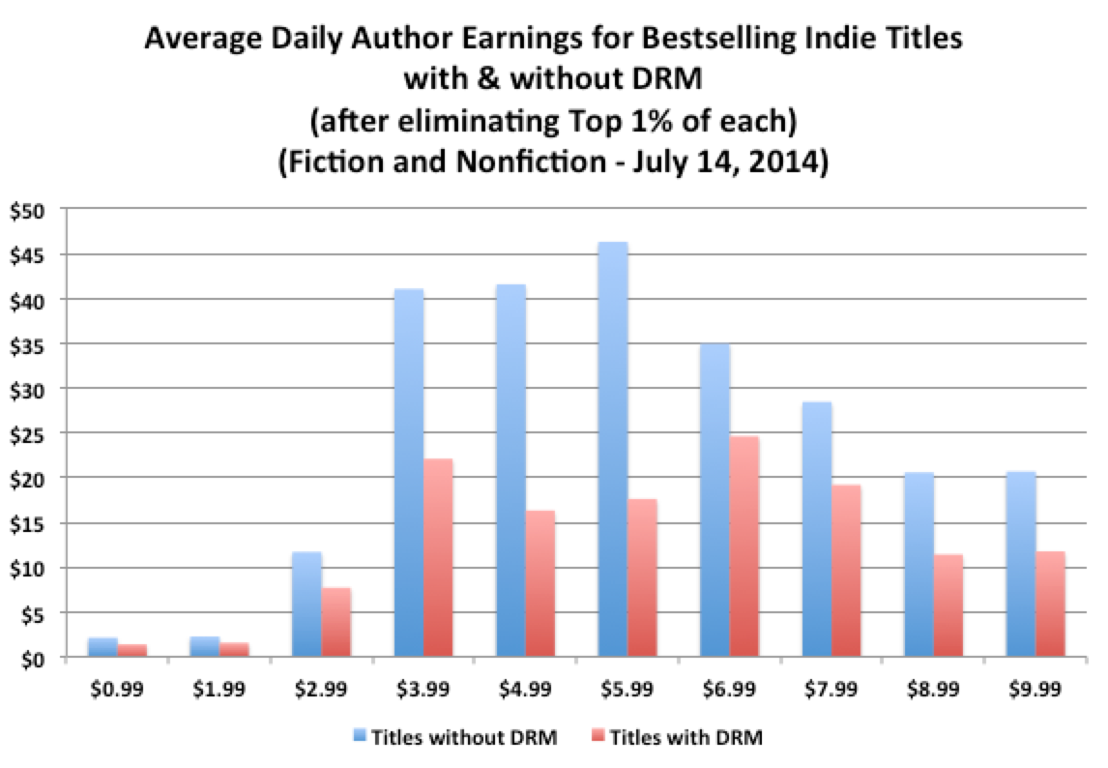
DRM- Free
Notes:
An Amazon earning report from 2014 indicates that e-books without DRM out-earned their DRM counterparts by 55% on average. This model makes you feel more like you own the product and less like you're renting it. (next slide)

Slide 38


Pay What You Want
Notes:
Pay what you want is a pricing strategy where buyers pay their desired amount for given content. Sometimes a suggested price may be indicated as guidance for the buyer. Yes, there will be freeloaders who pay nothing, or $.01, but there are just as many people who select an amount higher than the standard price for the content if they feel it is worth more than what is suggested. (next slide)

Slide 39

Offer Better Service/Incentives
Notes:
Offer better customer service or incentivize purchase. GOG.com offers drm-free game and indie video downloads. They make it easy to purchase content and guarantee compatibility, often modifying older games to make them compatible with newer systems and removing drm during this process (with publisher consent of course). In addition to the base content, they include incentives that other distributors often skip, such as soundtracks and artwork. (next slide)

Slide 40
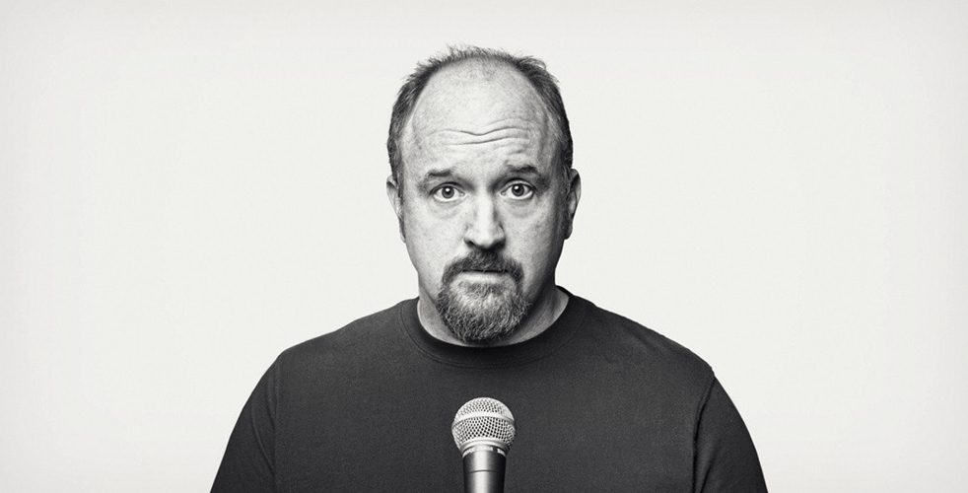
Offer Better Pricing
Notes:
And lastly, offer better prices. If it is easy to access and cheap enough, people will purchase rather than pirate. In 2011, comedian Louis C.K released his film ‘Live at the Beacon Theater’ for download on his website, drm-free, for $5. It turned a profit within 12 hours of release and within 10 days of release had made $1 million. (next slide)

Slide 41
Any questions?
Notes:
Any questions

